Slide 1

Computer Networking: A Top Down Approach
Seventh Edition
Chapter 6
The Link Layer and LANs
Slides in this presentation contain hyperlinks. JAWS users should be able to get a list of links by using INSERT+F7
Copyright © 2017, 2013, 2010 Pearson Education, Inc. All Rights Reserved
Notes:
If this PowerPoint presentation contains mathematical equations, you may need to check that your computer has the following installed:
1) MathType Plugin
2) Math Player (free versions available)
3) NVDA Reader (free versions available)

Slide 2
Link Layer and LANs
our goals:
understand principles behind link layer services:
error detection, correction
sharing a broadcast channel: multiple access
link layer addressing
local area networks: Ethernet, V LANs
instantiation, implementation of various link layer technologies

Slide 3
Learning Objectives (1 of 9)
6.1 introduction, services
6.2 error detection, correction
6.3 multiple access protocols
6.4 LANs
addressing, A R P
Ethernet
switches
V LANS
6.5 link virtualization: M P L S
6.6 data center networking
6.7 a day in the life of a web request

Slide 4
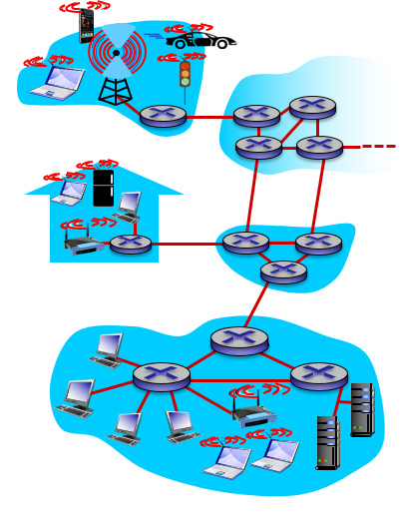
Link Layer: Introduction
terminology:
hosts and routers: nodes
communication channels that connect adjacent nodes along communication path: links
wired links
wireless links
LANs
layer-2 packet: frame, encapsulates datagram
data-link layer has responsibility of transferring datagram from one node to physically adjacent node over a link

Slide 5
Link Layer: Context
datagram transferred by different link protocols over different links:
e.g., Ethernet on first link, frame relay on intermediate links, 802.11 on last link
each link protocol provides different services
e.g., may or may not provide r d t over link
transportation analogy:
trip from Princeton to Lausanne
limo: Princeton to J F K
plane: J F K to Geneva
train: Geneva to Lausanne
tourist = datagram
transport segment = communication link
transportation mode = link layer protocol
travel agent = routing algorithm

Slide 6
Link Layer Services (1 of 2)
framing, link access:
encapsulate datagram into frame, adding header, trailer
channel access if shared medium
“MAC” addresses used in frame headers to identify source, destination
different from I P address!
reliable delivery between adjacent nodes
we learned how to do this already (chapter 3)!
seldom used on low bit-error link (fiber, some twisted pair)
wireless links: high error rates
Q: why both link-level and end-end reliability?

Slide 7
Link Layer Services (2 of 2)
flow control:
pacing between adjacent sending and receiving nodes
error detection:
errors caused by signal attenuation, noise.
receiver detects presence of errors:
signals sender for retransmission or drops frame
error correction:
receiver identifies and corrects bit error(s) without resorting to retransmission
half-duplex and full-duplex
with half duplex, nodes at both ends of link can transmit, but not at same time

Slide 8
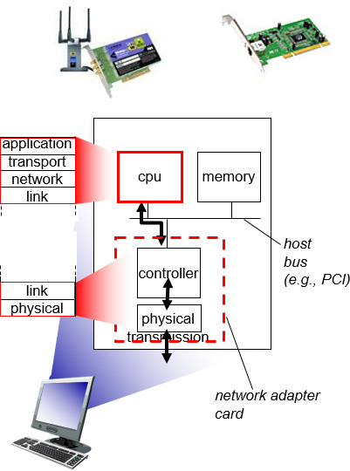
Where is the Link Layer Implemented?
in each and every host
link layer implemented in “adaptor” (aka network interface card N I C) or on a chip
Ethernet card, 802.11 card; Ethernet chipset
implements link, physical layer
attaches into host’s system buses
combination of hardware, software, firmware

Slide 9
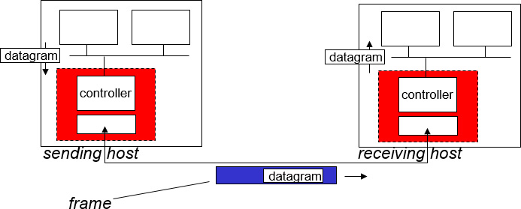
Adaptors Communicating
sending side:
encapsulates datagram in frame
adds error checking bits, rdt, flow control, etc.
receiving side
looks for errors, rdt, flow control, etc.
extracts datagram, passes to upper layer at receiving side

Slide 10
Learning Objectives (2 of 9)
6.1 introduction, services
6.2 error detection, correction
6.3 multiple access protocols
6.4 LANs
addressing, A R P
Ethernet
switches
V LANS
6.5 link virtualization: M P L S
6.6 data center networking
6.7 a day in the life of a web request

Slide 11
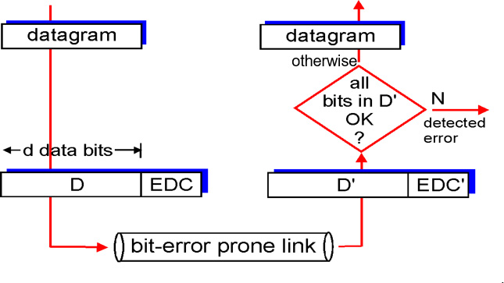
Error Detection
E D C = Error Detection and Correction bits (redundancy)
D = Data protected by error checking, may include header fields
Error detection not 100% reliable!
protocol may miss some errors, but rarely
larger E D C field yields better detection and correction

Slide 12
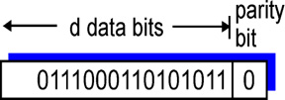
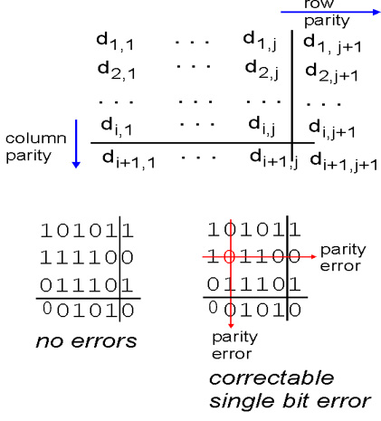
Parity Checking
single bit parity:
detect single bit errors
two-dimensional bit parity:
detect and correct single bit errors
* Check out the online interactive exercises for more examples: http://gaia.cs.umass.edu/kurose_ross/interactive/

Slide 13
Internet Checksum (Review)
goal: detect “errors” (e.g., flipped bits) in transmitted packet (note: used at transport layer only)
sender:
treat segment contents as sequence of 16-bit integers
checksum: addition (1’s complement sum) of segment contents
sender puts checksum value into U D P checksum field
receiver:
compute checksum of received segment
check if computed checksum equals checksum field value:
NO - error detected
YES - no error detected. But maybe errors nonetheless?

Slide 14
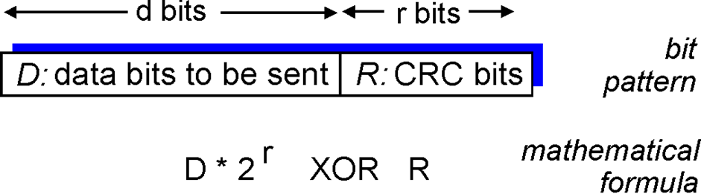
Cyclic Redundancy Check
more powerful error-detection coding
view data bits, D, as a binary number
choose r+1 bit pattern (generator), G
goal: choose r C R C bits, R, such that
<D,R> exactly divisible by G (modulo 2)
receiver knows G, divides <D,R> by G. If non-zero remainder: error detected!
can detect all burst errors less than r+1 bits
widely used in practice (Ethernet, 802.11 WiFi, A T M)

Slide 15
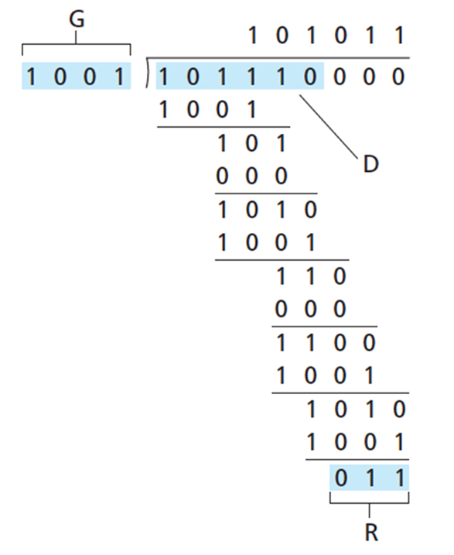
C R C Example
want:
equivalently:
equivalently:
if we divide
by G, want remainder R to satisfy:
* Check out the online interactive exercises for more examples: http://gaia.cs.umass.edu/kurose_ross/interactive/

Slide 16
Learning Objectives (3 of 9)
6.1 introduction, services
6.2 error detection, correction
6.3 multiple access protocols
6.4 LANs
addressing, A R P
Ethernet
switches
V LANS
6.5 link virtualization: M P L S
6.6 data center networking
6.7 a day in the life of a web request

Slide 17
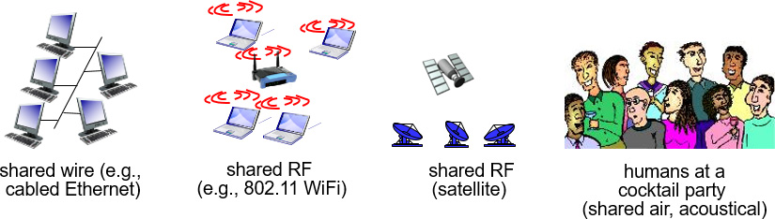
Multiple Access Links, Protocols
two types of “links”:
point-to-point
P P P for dial-up access
point-to-point link between Ethernet switch, host
broadcast (shared wire or medium)
old-fashioned Ethernet
upstream H F C
802.11 wireless LAN

Slide 18
Multiple Access Protocols
single shared broadcast channel
two or more simultaneous transmissions by nodes: interference
collision if node receives two or more signals at the same time
multiple access protocol
distributed algorithm that determines how nodes share channel, i.e., determine when node can transmit
communication about channel sharing must use channel itself!
no out-of-band channel for coordination

Slide 19
An Ideal Multiple Access Protocol
given: broadcast channel of rate R bps
desiderata:
when one node wants to transmit, it can send at rate R.
when M nodes want to transmit, each can send at average rate R/M
fully decentralized:
no special node to coordinate transmissions
no synchronization of clocks, slots
simple

Slide 20
M A C Protocols: Taxonomy
three broad classes:
channel partitioning
divide channel into smaller “pieces” (time slots, frequency, code)
allocate piece to node for exclusive use
random access
channel not divided, allow collisions
“recover” from collisions
“taking turns”
nodes take turns, but nodes with more to send can take longer turns

Slide 21
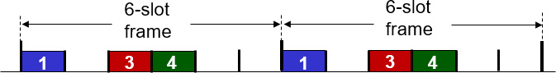
Channel Partitioning MAC Protocols: T D M A
T D M A: time division multiple access
access to channel in “rounds”
each station gets fixed length slot (length = packet transmission time) in each round
unused slots go idle
example: 6-station LAN, 1,3,4 have packets to send, slots 2,5,6 idle

Slide 22
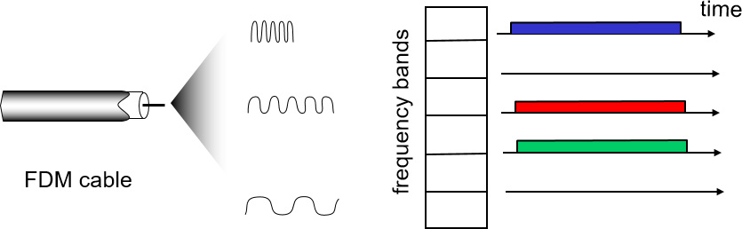
Channel Partitioning MAC Protocols: F D M A
F D M A: frequency division multiple access
channel spectrum divided into frequency bands
each station assigned fixed frequency band
unused transmission time in frequency bands go idle
example: 6-station LAN, 1,3,4 have packet to send, frequency bands 2,5,6 idle

Slide 23
Random Access Protocols
when node has packet to send
transmit at full channel data rate R.
no a priori coordination among nodes
two or more transmitting nodes → “collision”,
random access MAC protocol specifies:
how to detect collisions
how to recover from collisions (e.g., via delayed retransmissions)
examples of random access MAC protocols:
slotted A L O H A
A L O H A
C S M A, C S M A/C D, C S M A/C A

Slide 24
Slotted A L O H A (1 of 2)
assumptions:
all frames same size
time divided into equal size slots (time to transmit 1 frame)
nodes start to transmit only slot beginning
nodes are synchronized
if 2 or more nodes transmit in slot, all nodes detect collision
operation:
when node obtains fresh frame, transmits in next slot
if no collision: node can send new frame in next slot
if collision: node retransmits frame in each subsequent slot with prob. p until success

Slide 25
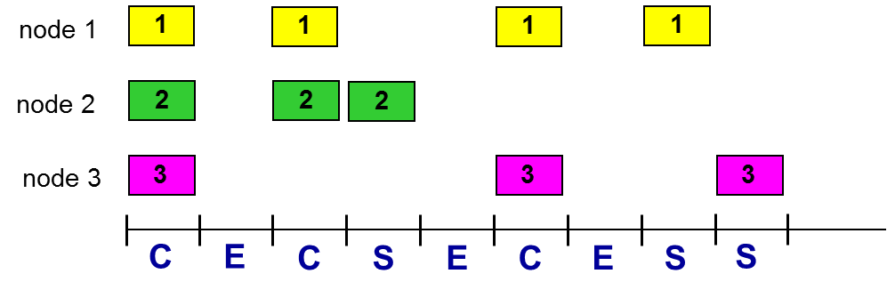
Slotted A L O H A (2 of 2)
Pros:
single active node can continuously transmit at full rate of channel
highly decentralized: only slots in nodes need to be in sync
simple
Cons:
collisions, wasting slots
idle slots
nodes may be able to detect collision in less than time to transmit packet
clock synchronization

Slide 26
Slotted A L O H A: Efficiency (1 of 2)
efficiency: long-run fraction of successful slots (many nodes, all with many frames to send)
suppose: N nodes with many frames to send, each transmits in slot with probability p
prob that given node has success in a slot
prob that any node has a success

Slide 27

Slotted A L O H A: Efficiency (2 of 2)
max efficiency: find
that maximizes
for many nodes, take limit of
as N goes to infinity, gives:
at best: channel used for useful transmissions 37% of time!

Slide 28
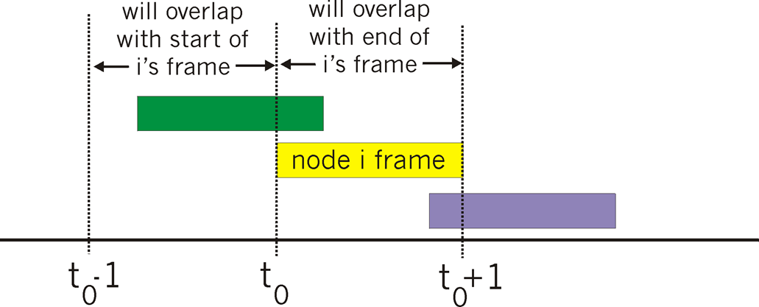
Pure (Unslotted) A L O H A
unslotted Aloha: simpler, no synchronization
when frame first arrives
transmit immediately
collision probability increases:
frame sent at t₀ collides with other frames sent in [t₀-1,t₀+1]

Slide 29
Pure A L O H A Efficiency
P(success by given node) = P(node transmits)
P(no other node transmits in [t₀-1,t₀]
P(no other node transmits in [t₀-1,t₀]
… choosing optimum p and then letting
even worse than slotted Aloha!

Slide 30
C S M A (Carrier Sense Multiple Access)
C S M A: listen before transmit:
if channel sensed idle: transmit entire frame
if channel sensed busy, defer transmission
human analogy: don’t interrupt others!

Slide 31
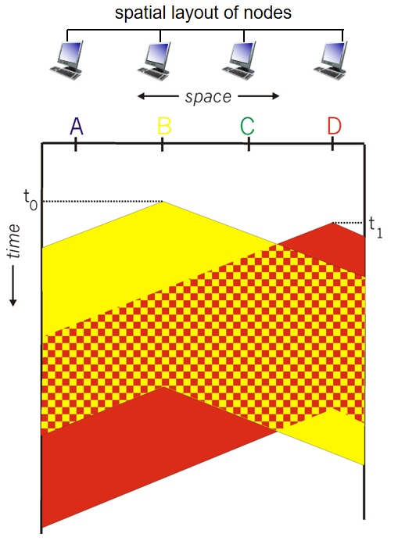
C S M A Collisions
collisions can still occur: propagation delay means two nodes may not hear each other’s transmission
collision: entire packet transmission time wasted
distance & propagation delay play role in in determining collision probability

Slide 32
C S M A/C D (Collision Detection) (1 of 2)
C S M A/C D: carrier sensing, deferral as in C S M A
collisions detected within short time
colliding transmissions aborted, reducing channel wastage
collision detection:
easy in wired LANs: measure signal strengths, compare transmitted, received signals
difficult in wireless LANs: received signal strength overwhelmed by local transmission strength
human analogy: the polite conversationalist

Slide 33
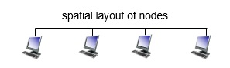
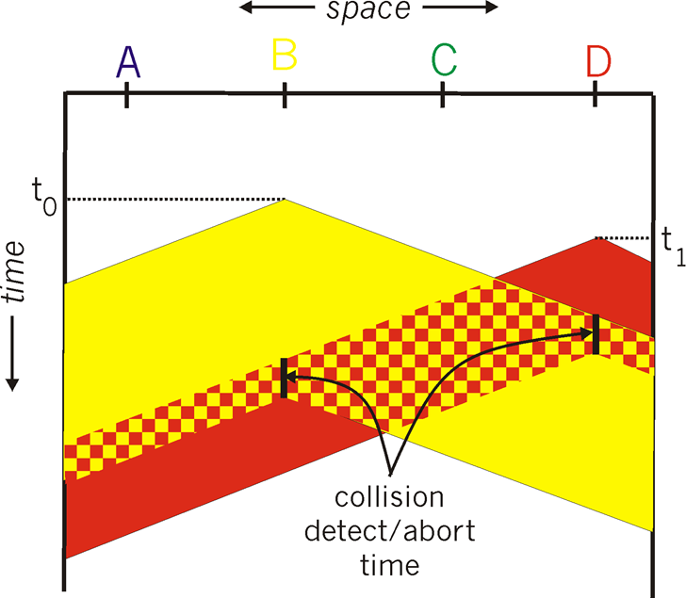
C S M A/C D (Collision Detection) (2 of 2)

Slide 34
Ethernet C S M A/C D Algorithm
N I C receives datagram from network layer, creates frame
If N I C senses channel idle, starts frame transmission. If N I C senses channel busy, waits until channel idle, then transmits.
If N I C transmits entire frame without detecting another transmission, N I C is done with frame !
If N I C detects another transmission while transmitting, aborts and sends jam signal
After aborting, N I C enters binary (exponential) backoff:
after mth collision, N I C chooses K at random from
N I C waits K·512 bit times, returns to Step 2
longer backoff interval with more collisions

Slide 35
C S M A/C D Efficiency
T_{prop} = max prop delay between 2 nodes in LAN
t_{trans} = time to transmit max-size frame
efficiency goes to 1
as t_{prop} goes to 0
as t_{trans} goes to infinity
better performance than A L O H A: and simple, cheap, decentralized!

Slide 36
“Taking Turns” MAC Protocols (1 of 3)
channel partitioning MAC protocols:
share channel efficiently and fairly at high load
inefficient at low load: delay in channel access, 1/N bandwidth allocated even if only 1 active node!
random access MAC protocols
efficient at low load: single node can fully utilize channel
high load: collision overhead
“taking turns” protocols
look for best of both worlds!

Slide 37
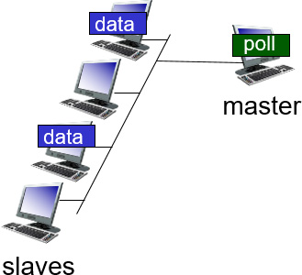
“Taking Turns” MAC Protocols (2 of 3)
polling:
master node “invites” slave nodes to transmit in turn
typically used with “dumb” slave devices
concerns:
polling overhead
latency
single point of failure (master)np

Slide 38
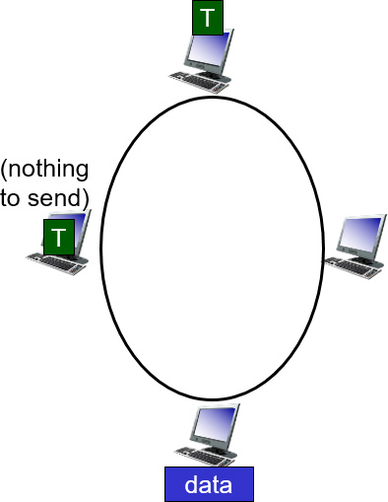
“Taking Turns” MAC Protocols (3 of 3)
token passing:
control token passed from one node to next sequentially.
token message
concerns:
token overhead
latency
single point of failure (token)

Slide 39
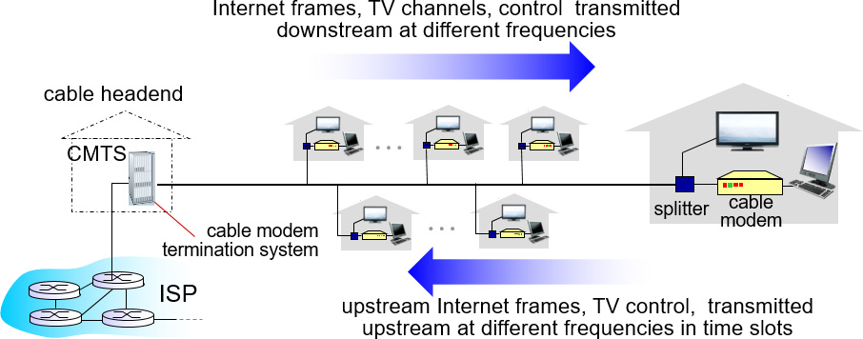
Cable Access Network (1 of 2)
multiple 40 M b p s downstream (broadcast) channels
single C M T S transmits into channels
multiple 30 M b p s upstream channels
multiple access: all users contend for certain upstream channel time slots (others assigned)

Slide 40
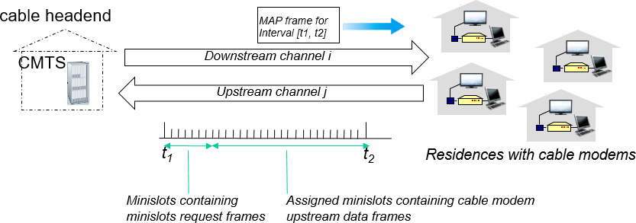
Cable Access Network (2 of 2)
D O C S I S: data over cable service interface spec
F D M over upstream, downstream frequency channels
T D M upstream: some slots assigned, some have contention
downstream M A P frame: assigns upstream slots
request for upstream slots (and data) transmitted random access (binary backoff) in selected slots

Slide 41
Summary of MAC Protocols
channel partitioning, by time, frequency or code
Time Division, Frequency Division
random access (dynamic),
A L O H A, S-A L O H A, C S M A, C S M A/C D
carrier sensing: easy in some technologies (wire), hard in others (wireless)
C S M A / C D used in Ethernet
C S M A / C A used in 802.11
taking turns
polling from central site, token passing
Bluetooth, F D D I, token ring

Slide 42
Learning Objectives (4 of 9)
6.1 introduction, services
6.2 error detection, correction
6.3 multiple access protocols
6.4 LANs
addressing, A R P
Ethernet
switches
V LANS
6.5 link virtualization: M P L S
6.6 data center networking
6.7 a day in the life of a web request

Slide 43
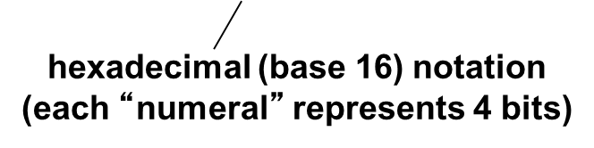
MAC Addresses and A R P
32-bit I P address:
network-layer address for interface
used for layer 3 (network layer) forwarding
MAC (or LAN or physical or Ethernet) address:
function: used ‘locally” to get frame from one interface to another physically-connected interface (same network, in I P-addressing sense)
48 bit MAC address (for most LANs) burned in N I C R O M, also sometimes software settable
e.g.: 1 A-2 F-B B-76-09-A D

Slide 44
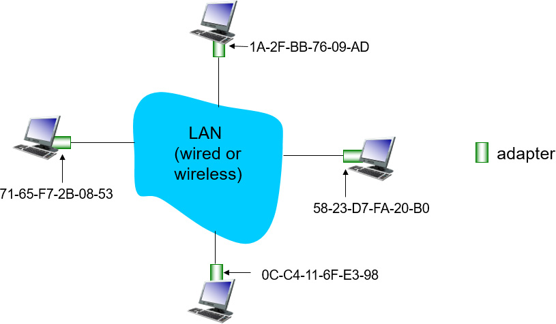
LAN Addresses and A R P
each adapter on LAN has unique LAN address

Slide 45
LAN Addresses
MAC address allocation administered by I E E E
manufacturer buys portion of MAC address space (to assure uniqueness)
analogy:
MAC address: like Social Security Number
I P address: like postal address
MAC flat address → portability
can move LAN card from one LAN to another
I P hierarchical address not portable
address depends on I P subnet to which node is attached

Slide 46
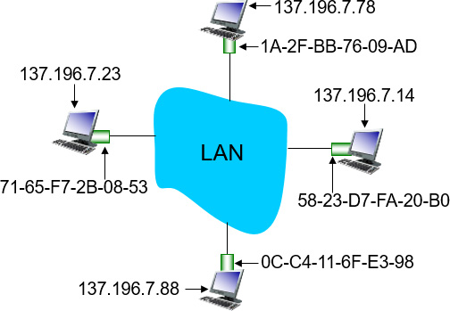
A R P: Address Resolution Protocol
Question: how to determine interface’s M A C address, knowing its IP address?
A R P table: each I P node (host, router) on LAN has table
I P/MAC address mappings for some LAN nodes:
< I P address; MAC address; T T L>
T T L (Time To Live): time after which address mapping will be forgotten (typically 20 min)

Slide 47
A R P Protocol: Same LAN (1 of 2)
A wants to send datagram to B
B’s MAC address not in A’s A R P table.
A broadcasts A R P query packet, containing B’s I P address
destination M A C address = FF-FF-FF-FF-FF-FF
all nodes on LAN receive A R P query
B receives A R P packet, replies to A with its (B’s) M A C address
frame sent to A’s MAC address (unicast)

Slide 48
A R P Protocol: Same LAN (2 of 2)
A caches (saves) I P-to-MAC address pair in its A R P table until information becomes old (times out)
soft state: information that times out (goes away) unless refreshed
A R P is “plug-and-play”:
nodes create their A R P tables without intervention from net administrator

Slide 49
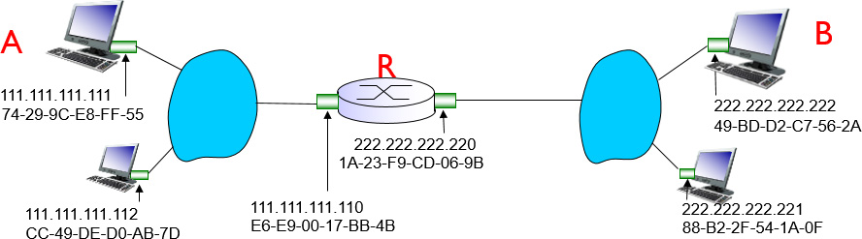
Addressing: Routing to Another LAN (1 of 5)
walkthrough: send datagram from A to B via R
focus on addressing – at I P (datagram) and MAC layer (frame)
assume A knows B’s I P address
assume A knows I P address of first hop router, R (how?)
assume A knows R’s MAC address (how?)

Slide 50
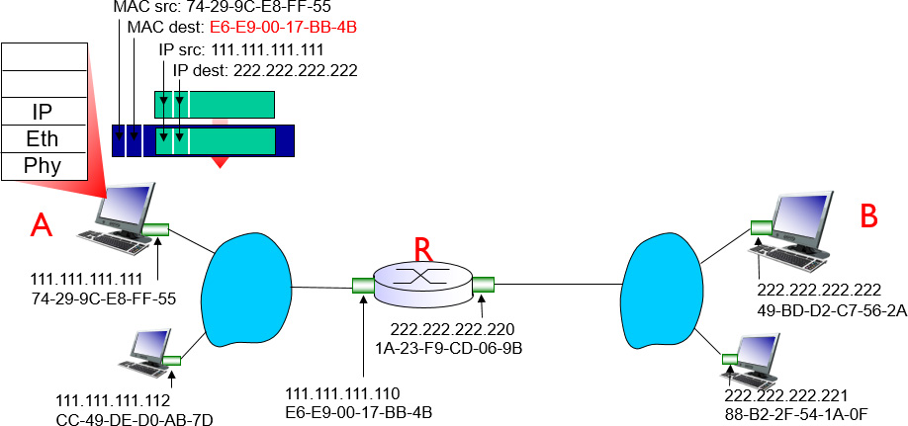
Addressing: Routing to Another LAN (2 of 5)
A creates I P datagram with I P source A, destination B
A creates link-layer frame with R’s MAC address as destination address, frame contains A-to-B I P datagram

Slide 51
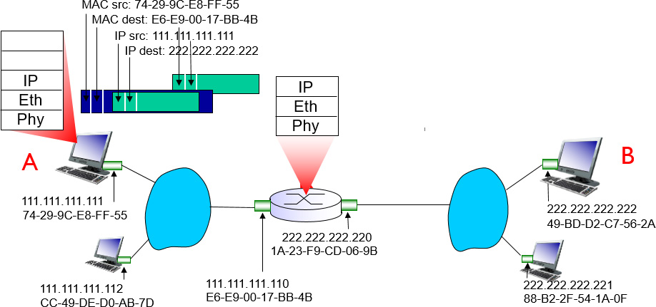
Addressing: Routing to Another LAN (3 of 5)
frame sent from A to R
frame received at R, datagram removed, passed up to I P

Slide 52
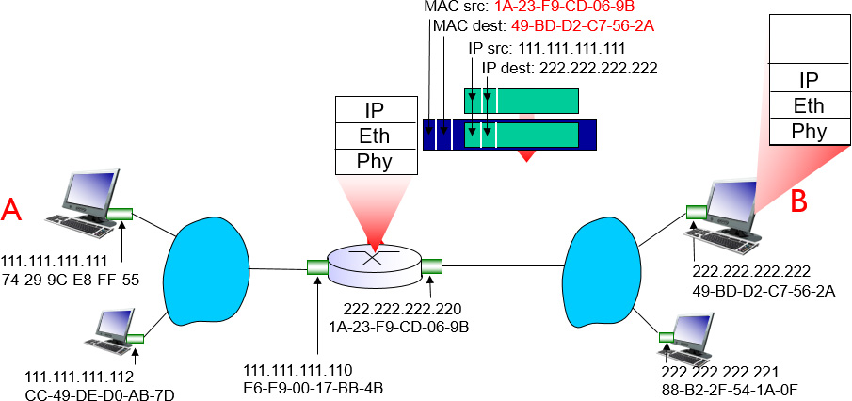
Addressing: Routing to Another LAN (4 of 5)
R forwards datagram with I P source A, destination B
R creates link-layer frame with B‘s MAC address as destination address, frame contains A-to-B I P datagram

Slide 53
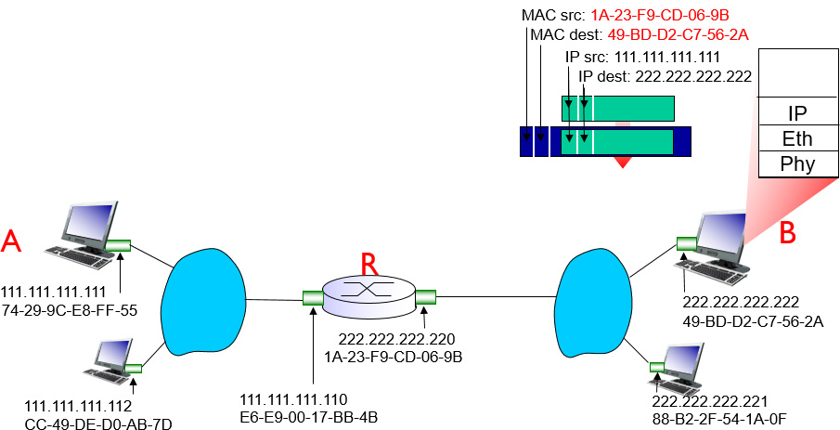
Addressing: Routing to Another LAN (5 of 5)
R forwards datagram with I P source A, destination B
R creates link-layer frame with B's MAC address as dest, frame contains A-to-B I P datagram
Check out the online interactive exercises for more examples: http://gaia.cs.umass.edu/kurose_ross/interactive/

Slide 54
Learning Objectives (5 of 9)
6.1 introduction, services
6.2 error detection, correction
6.3 multiple access protocols
6.4 LANs
addressing, A R P
Ethernet
switches
V LANS
6.5 link virtualization: M P L S
6.6 data center networking
6.7 a day in the life of a web request

Slide 55
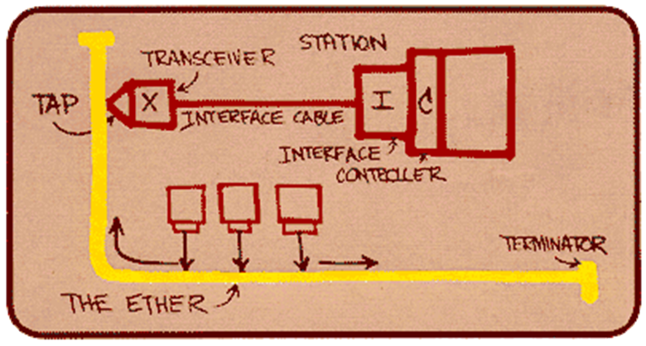
Ethernet
“dominant” wired LAN technology:
single chip, multiple speeds (e.g., Broadcom B C M 5761)
first widely used LAN technology
simpler, cheap
kept up with speed race: 10 M b p s – 10 G b p s
Metcalfe’s Ethernet sketch

Slide 56
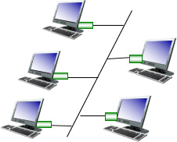
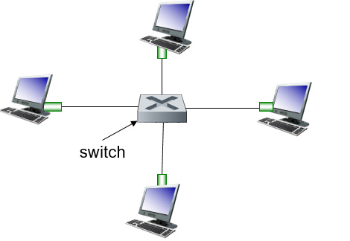
Ethernet: Physical Topology
bus: popular through mid 90s
all nodes in same collision domain (can collide with each other)
star: prevails today
active switch in center
each “spoke” runs a (separate) Ethernet protocol (nodes do not collide with each other)
bus: coaxial cable
star

Slide 57
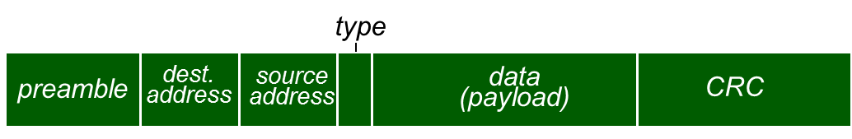
Ethernet Frame Structure (1 of 2)
sending adapter encapsulates I P datagram (or other network layer protocol packet) in Ethernet frame
preamble:
7 bytes with pattern 10101010 followed by one byte with pattern 10101011
used to synchronize receiver, sender clock rates

Slide 58

Ethernet Frame Structure (2 of 2)
addresses: 6 byte source, destination MAC addresses
if adapter receives frame with matching destination address, or with broadcast address (e.g. A R P packet), it passes data in frame to network layer protocol
otherwise, adapter discards frame
type: indicates higher layer protocol (mostly I P but others possible, e.g., Novell I P X, AppleTalk)
C R C: cyclic redundancy check at receiver
error detected: frame is dropped

Slide 59
Ethernet: Unreliable, Connectionless
connectionless: no handshaking between sending and receiving N I C s
unreliable: receiving N I C doesn't send acks or nacks to sending N I C
data in dropped frames recovered only if initial sender uses higher layer rdt (e.g., T C P), otherwise dropped data lost
Ethernet’s MAC protocol: unslotted C S M A/C D with binary backoff

Slide 60
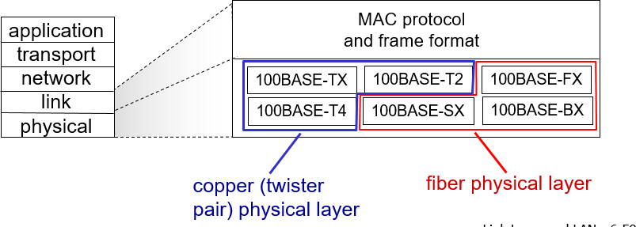
802.3 Ethernet Standards: Link & Physical Layers
many different Ethernet standards
common MAC protocol and frame format
different speeds: 2 M b p s, 10 M b p s, 100 M b p s, 1G b p s, 10 G b3p s, 40 G b p s
different physical layer media: fiber, cable

Slide 61
Learning Objectives (6 of 9)
6.1 introduction, services
6.2 error detection, correction
6.3 multiple access protocols
6.4 LANs
addressing, A R P
Ethernet
switches
V LANS
6.5 link virtualization: M P L S
6.6 data center networking
6.7 a day in the life of a web request

Slide 62
Ethernet Switch
link-layer device: takes an active role
store, forward Ethernet frames
examine incoming frame’s M A C address, selectively forward frame to one-or-more outgoing links when frame is to be forwarded on segment, uses C S M A/ C D to access segment
transparent
hosts are unaware of presence of switches
plug-and-play, self-learning
switches do not need to be configured

Slide 63
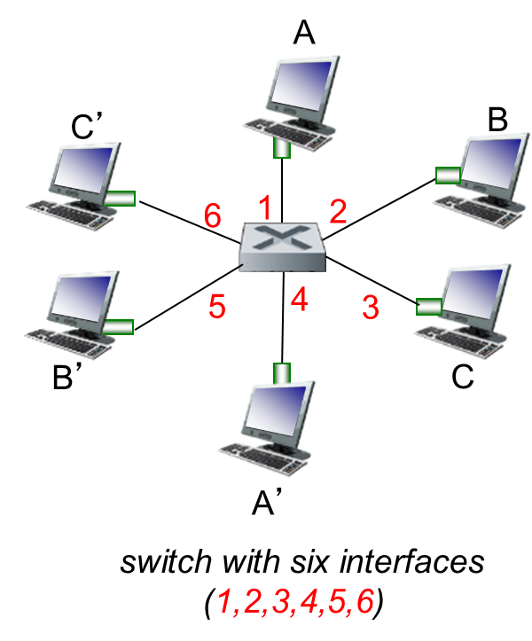
Switch: Multiple Simultaneous Transmissions
hosts have dedicated, direct connection to switch
switches buffer packets
Ethernet protocol used on each incoming link, but no collisions; full duplex
each link is its own collision domain
switching: A-to-A’ and B-to-B’ can transmit simultaneously, without collisions

Slide 64
Switch Forwarding Table
Q: how does switch know A’ reachable via interface 4, B’ reachable via interface 5?
A: each switch has a switch table, each entry:
(M A C address of host, interface to reach host, time stamp)
looks like a routing table!
Q: how are entries created, maintained in switch table?
something like a routing protocol?

Slide 65
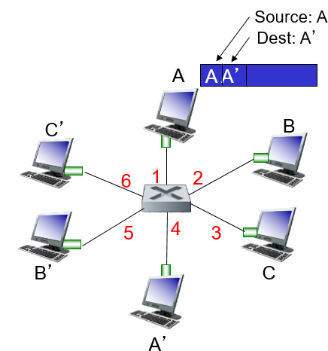
Switch: Self-Learning
switch learns which hosts can be reached through which interfaces
when frame received, switch “learns” location of sender: incoming LAN segment
records sender/location pair in switch table
MAC addr | interface | T T L
A | 1 | 60
Switch table (initially empty)

Slide 66
Switch: Frame Filtering/Forwarding
when frame received at switch:
record incoming link, MAC address of sending host
index switch table using MAC destination address
if entry found for destination
then {
if destination on segment from which frame arrived then drop frame
else forward frame on interface indicated by entry
}
else flood /* forward on all interfaces except arriving interface */

Slide 67
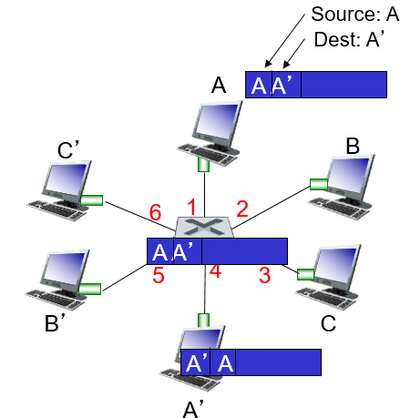
Self-Learning, Forwarding: Example
frame destination, A’, location unknown:flood
destination A location known:selectively send on just one link
MAC addr | interface | TTL
A A’ | 1 4 | 60 60
switch table (initially empty)

Slide 68
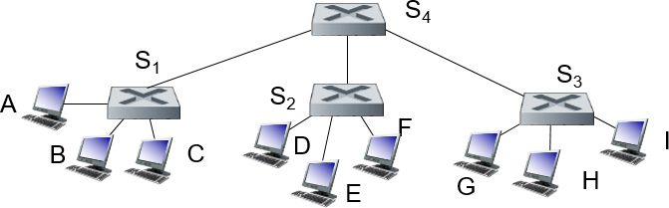
Interconnecting Switches
self-learning switches can be connected together:
Q: sending from A to G - how does S₁ know to forward frame destined to G via S₄ and S₃?
A: self learning! (works exactly the same as in single-switch case!)

Slide 69

Self-Learning Multi-Switch Example
Suppose C sends frame to I, I responds to C
Q: show switch tables and packet forwarding in S₁, S₂, S₃, S₄

Slide 70
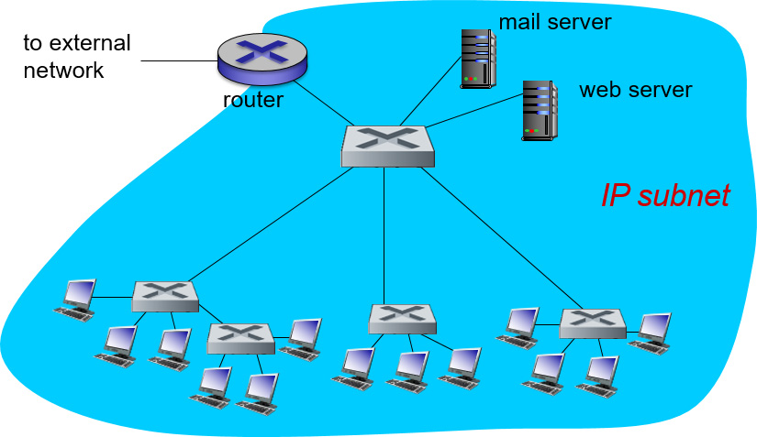
Institutional Network

Slide 71
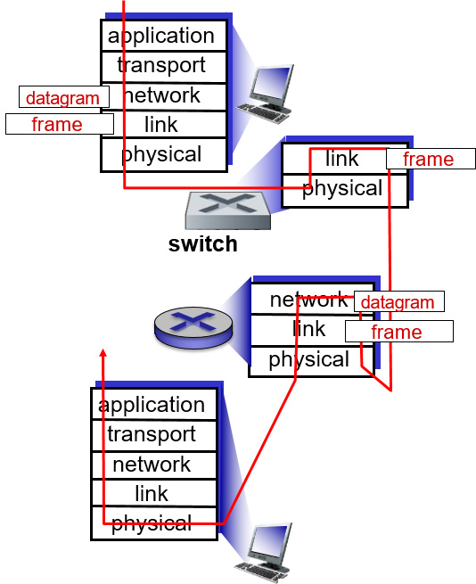
Switches vs. Routers
both are store-and-forward:
routers: network-layer devices (examine network-layer headers)
switches: link-layer devices (examine link-layer headers)
both have forwarding tables:
routers: compute tables using routing algorithms, I P addresses
switches: learn forwarding table using flooding, learning, MAC addresses

Slide 72
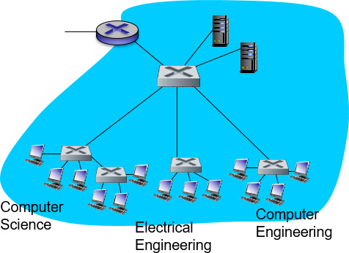
V LANs: Motivation
consider:
C S user moves office to E E, but wants connect to C S switch?
single broadcast domain:
all layer-2 broadcast traffic (A R P, D H C P, unknown location of destination MAC address) must cross entire LAN
security/privacy, efficiency issues

Slide 73
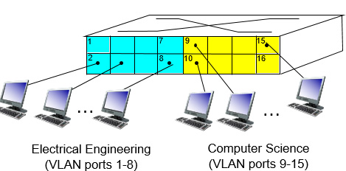
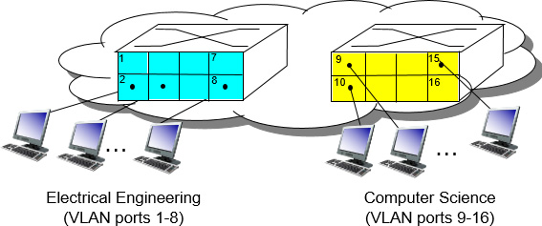
V LANs
Virtual Local Area Network
switch(e s) supporting V LAN capabilities can be configured to define multiple virtual LANS over single physical LAN infrastructure.
port-based V LAN: switch ports grouped (by switch management software) so that single physical switch ……
… operates as multiple virtual switches

Slide 74
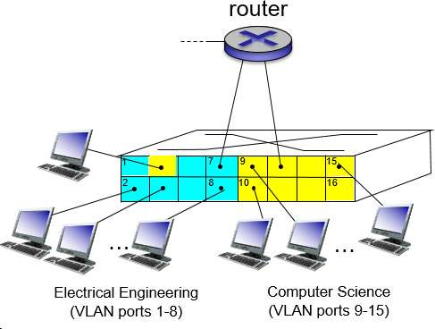
Port-Based V LAN
traffic isolation: frames to/from ports 1-8 can only reach ports 1-8
can also define V LAN based on M A C addresses of endpoints, rather than switch port
dynamic membership: ports can be dynamically assigned among V LANs
forwarding between V LANS: done via routing (just as with separate switches)
in practice vendors sell combined switches plus routers

Slide 75
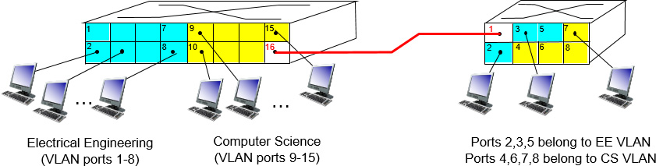
V LANS Spanning Multiple Switches
trunk port: carries frames between V LANs defined over multiple physical switches
frames forwarded within V LAN between switches can’t be vanilla 802.1 frames (must carry V LAN I D info)
802.1q protocol adds/removed additional header fields for frames forwarded between trunk ports

Slide 76
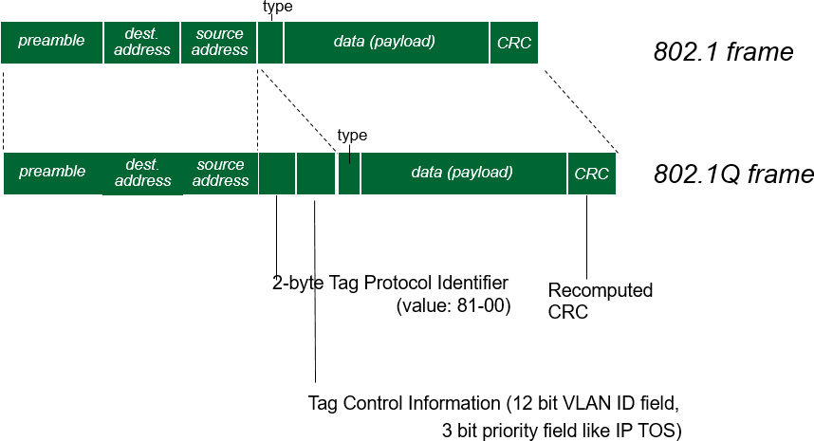
802.1Q V LAN Frame Format

Slide 77
Learning Objectives (7 of 9)
6.1 introduction, services
6.2 error detection, correction
6.3 multiple access protocols
6.4 LANs
addressing, A R P
Ethernet
switches
V LANS
6.5 link virtualization: M P L S
6.6 data center networking
6.7 a day in the life of a web request

Slide 78
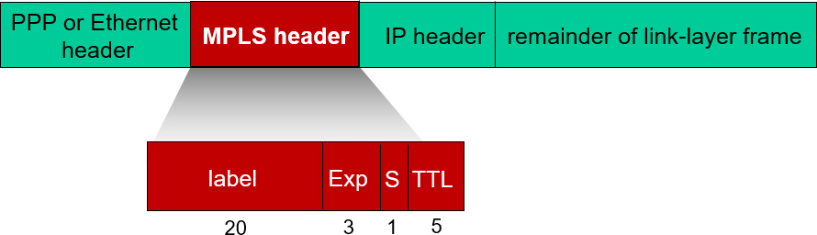
Multiprotocol Label Switching (M P L S)
initial goal: high-speed I P forwarding using fixed length label (instead of I P address)
fast lookup using fixed length identifier (rather than shortest prefix matching)
borrowing ideas from Virtual Circuit (V C) approach
but I P datagram still keeps I P address!

Slide 79
M P L S Capable Routers
a.k.a. label-switched router
forward packets to outgoing interface based only on label value (don’t inspect I P address)
M P L S forwarding table distinct from I P forwarding tables
flexibility: M P L S forwarding decisions can differ from those of I P
use destination and source addresses to route flows to same destination differently (traffic engineering)
re-route flows quickly if link fails: pre-computed backup paths (useful for VoIP)

Slide 80
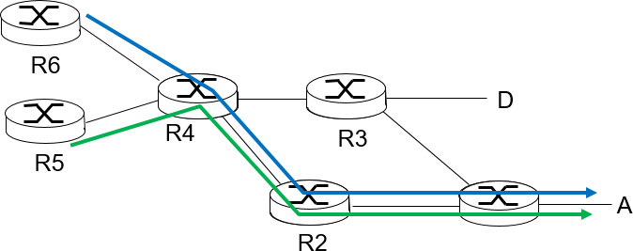

M P L S Versus I P Paths (1 of 2)
I P routing: path to destination determined by destination address alone

Slide 81
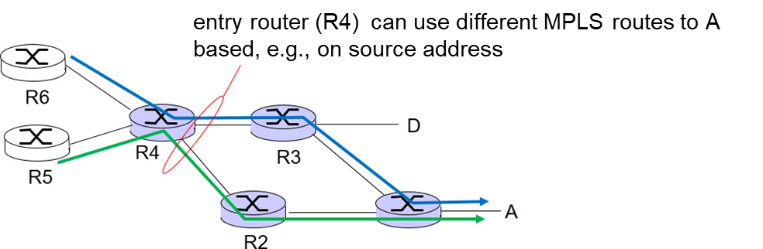

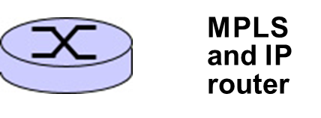
M P L S Versus I P Paths (2 of 2)
I P routing: path to destination determined by destination address alone
M P L S routing: path to destination can be based on source and destination address
fast reroute: precompute backup routes in case of link failure

Slide 82
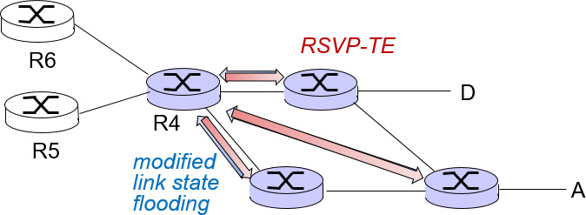
M P L S Signaling
modify O S P F, I S-I S link-state flooding protocols to carry info used by M P L S routing,
e.g., link bandwidth, amount of “reserved” link bandwidth
entry M P L S router uses R S V P - T E signaling protocol to set up M P L S forwarding at downstream routers

Slide 83

M P L S Forwarding Tables

Slide 84
Learning Objectives (8 of 9)
6.1 introduction, services
6.2 error detection, correction
6.3 multiple access protocols
6.4 LANs
addressing, A R P
Ethernet
switches
V LANS
6.5 link virtualization: M P L S
6.6 data center networking
6.7 a day in the life of a web request

Slide 85

Data Center Networks (1 of 3)
10’s to 100’s of thousands of hosts, often closely coupled, in close proximity:
e-business (e.g. Amazon)
content-servers (e.g., YouTube, Akamai, Apple, Microsoft)
search engines, data mining (e.g., Google)
challenges:
multiple applications, each serving massive numbers of clients
managing/balancing load, avoiding processing, networking, data bottlenecks
Inside a 40-f t Microsoft container, Chicago data center

Slide 86

Data Center Networks (2 of 3)
load balancer: application-layer routing
receives external client requests
directs workload within data center
returns results to external client (hiding data center internals from client)

Slide 87

Data Center Networks (3 of 3)
rich interconnection among switches, racks:
increased throughput between racks (multiple routing paths possible)
increased reliability via redundancy

Slide 88
Learning Objectives (9 of 9)
6.1 introduction, services
6.2 error detection, correction
6.3 multiple access protocols
6.4 LANs
addressing, A R P
Ethernet
switches
V LANS
6.5 link virtualization: M P L S
6.6 data center networking
6.7 a day in the life of a web request

Slide 89
Synthesis: A Day in the Life of a Web Request
journey down protocol stack complete!
application, transport, network, link
putting-it-all-together: synthesis!
goal: identify, review, understand protocols (at all layers) involved in seemingly simple scenario: requesting www page
scenario: student attaches laptop to campus network, requests/receives www.google.com

Slide 90

A Day in the Life: Scenario

Slide 91

A Day in the Life… Connecting to the Internet (1 of 3)
connecting laptop needs to get its own I P address, addr of first-hop router, addr of D N S server: use D H C P
D H C P request encapsulated in U D P, encapsulated in I P, encapsulated in 802.3 Ethernet
Ethernet frame broadcast (dest: F F F F F F F F F F F F) on LAN, received at router running D H C P server
Ethernet demuxed to I P demuxed, U D P demuxed to D H C P

Slide 92

A Day in the Life… Connecting to the Internet (2 of 3)
D H C P server formulates D H C P A C K containing client’s I P address, I P address of first-hop router for client, name & I P address of D N S server
encapsulation at D H C P server, frame forwarded (switch learning) through L A N, demultiplexing at client
D H C P client receives D H C P A C K reply
Client now has I P address, knows name & addr of D N S server, I P address of its first-hop router

Slide 93

A Day in the Life… Connecting to the Internet (3 of 3)
before sending H T T P request, need IP address of www.google.com: D N S
D N S query created, encapsulated in U D P, encapsulated in I P, encapsulated in E th. To send frame to router, need M A C address of router interface: A R P
A R P query broadcast, received by router, which replies with A R P reply giving MAC address of router interface
client now knows M A C address of first hop router, so can now send frame containing D N S query

Slide 94

A Day in the Life… Using D N S
I P datagram forwarded from campus network into Comcast network, routed (tables created by R I P, O S P F, I S – I S and/or B G P routing protocols) to D N S server
demuxed to D N S server
D N S server replies to client with I P address of www.google.com
I P datagram containing D N S query forwarded via LAN switch from client to 1st hop router

Slide 95

A Day in the Life…T C P Connection Carrying H T T P
to send H T T P request, client first opens T C P socket to web server
T C P S Y N segment (step 1 in 3-way handshake) inter-domain routed to web server
web server responds with T C P S Y N A C K (step 2 in 3-way handshake)
T C P connection established!

Slide 96

A Day in the Life… H T T P Request/Reply
H T T P request sent into T C P socket
I P datagram containing H T T P request routed to www.google.com
web server responds with H T T P reply (containing web page)
I P datagram containing H T T P reply routed back to client
web page finally (!!!) displayed

Slide 97
Chapter 6: Summary
principles behind data link layer services:
error detection, correction
sharing a broadcast channel: multiple access
link layer addressing
instantiation and implementation of various link layer technologies
Ethernet
switched LANS, V LANs
virtualized networks as a link layer: M P L S
synthesis: a day in the life of a web request

Slide 98
Chapter 6: Let’s Take a Breath
journey down protocol stack complete (except P H Y)
solid understanding of networking principles, practice
….. could stop here …. but lots of interesting topics!
wireless
multimedia
security

Slide 99

Copyright

